Slide 1
CS 4350: Fundamentals of Software Engineering Lesson 1.1 Course Introduction
Adeel Bhutta, Frank Tip, Jan Vitek, Mitch Wand
Khoury College of Computer Sciences
What shall we put for the copyright line?
© 2021 Jonathan Bell, John Boyland, Mitch Wand, Frank Tip. Released under the CC BY-SA license

Slide 2
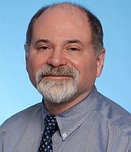


Instructors
Need New Pix
Mitch Wand
John Boyland
Jonathan Bell

Slide 3
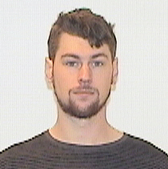

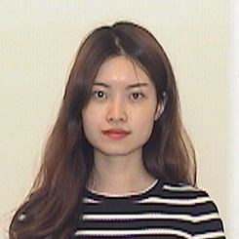
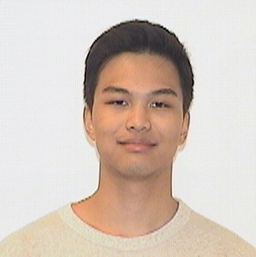
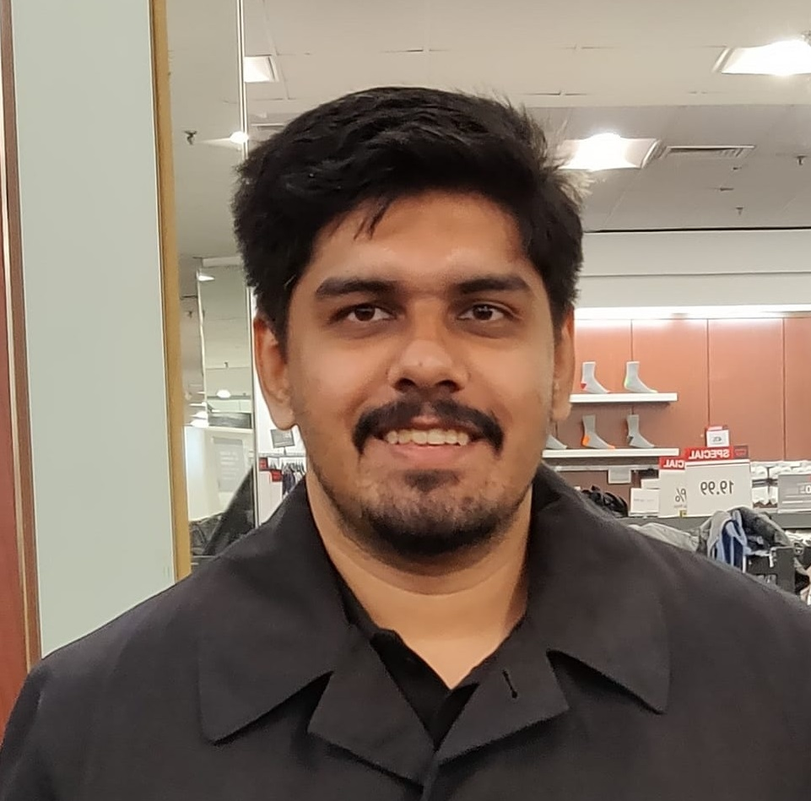
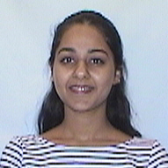

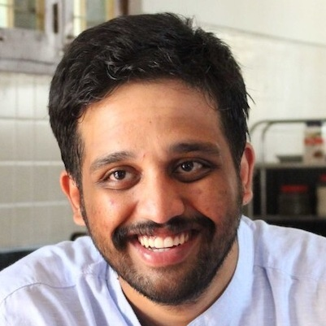
Teaching Assistants
Need New Pix
Joseph Burns
Michael Davinroy
Yuting Gan
Eiki Kan
Satyajit Gokhale
Guneet Kaur
Ben Schultze
Sagar Madhu Ayi

Slide 4
What is software engineering?
Software Engineering refers to the tools and processes that we use to
design,
construct, and
maintain programs
over time.

Slide 5
Good code is necessary but not sufficient
Developing software is a systems enterprise
there are many stakeholders
how to determine the requirements?
how to design code for:
reuse, readability, scale? other factors?
how to organize the development process?
how to make sure you've built the right thing?
how to make sure you've built the thing right?

Slide 6
SE includes Tools and Processes
The answers to those questions will depend on things like:
the size of the team
the size of the product
the longevity of the product
There's no one "right" way; there are always tradeoffs.
But there are best practices, which we will expect you to follow.

Slide 7
Learning Objectives for this course:
By the end of this course you will--
Be able to define and describe the phases of the software engineering lifecycle.
Be able to explain the role of key processes and technologies in modern software development.
Be able to productively apply instances of major tools used in elementary SE tasks.
Design and implement a portfolio-worthy software engineering project in a small team environment that can be showcased to recruiters.
Delete?
Update?
Notes:
other factors: careful design, extensible solutions, effective teamwork, etc.

Slide 8
Learning Objectives for this Lesson
By the end of this lesson you should be able to:
Explain what SE is and why it’s important
List your weekly obligations as a student
List the requirements for completing the course
Explain how assignments will be graded

Slide 9
Approach
The course will mirror the steps of the software engineering life cycle
starting with requirements, through testing and deployment
we will move some material forward to make sure that you have the learning you need when you need it
Will start with several individual homework assignments
Then a group project, done in teams of about 4 people
Update?

Slide 10
Technology
We will use:
TypeScript as implementation language
Visual Studio Code as our IDE
REACT for web pages
Also git, and other miscellaneous tools

Slide 11
Course Mechanics
Our goal is to provide a productive learning environment to both remote and on-the-ground students
100% attendance is expected for both on-the-ground and remote sections
Classes will include both lectures and in-class activities.
Be sure to bring your laptop
Weekly slides will be posted in advance, so be prepared to ask and answer questions about the material.
Let's discuss. Having lessons online in advance is important for me.

Slide 12
Laboratories (Tutorials)
There will be regular laboratory exercises to give you practice with the technologies we will use.
Not graded, but highly recommended
Typically, will consist of structured steps that will guide you through a typical task
Update?

Slide 13
Course Requirements
There will be three homework assignments due during the first half of the term, plus a final project that will be due at the end of the term.
You will complete the assignments individually, and the project in a group of 3 or 4.
The overall grading breakdown is:
35% Homeworks
35% Team Project
10% Quizzes and in-class activities
20% Final Exam
There will/will not be a final exam
Need to decide on # of assignments
Need to decide about final

Slide 14
Grading (1)
We will be using a new grading system this semester, called "specification grading".
In this system, we will give a rating on each element of each assignment.
there will be exactly three possible ratings for each element:
below minimum expectations
meets minimum expectations
satisfactory
Maybe just don't say anything about grading here.

Slide 15
Grading (2)
This is called "specification grading" because we will be as precise as we can to specify what is necessary for you to achieve each rating.
Here's an example from a hypothetical assignment about code review:
Weight in Assignment | Criterion | Meets Minimum Expectations | Satisfactory
4% | Naming | Identify at least 1 good name and 1 bad name in the code base. Some examples may not be well-grounded in a design rationale | Identify at least 3 “good” names and 3 “bad” names. Each example is substantiated with 1 sentence justifying why this is a good or bad name.

Slide 16
Grading (3)
Note: there is no partial credit. For each gradable element you will get exactly one of those 3 ratings.
The factors that we might have considered for partial credit will be broken out into separate elements. The elements will be aligned, as best we can, with the stated learning objectives of the assignment.
You will know the rating criteria before you do the assignment.
At the end of each assignment, you will receive
your rating on each of the elements in the assignment
a 3-tuple, with the weighted total of "below minimums", "minimums" and "satisfactories" that you got.
So in the example, if you got a "satisfactory", that would count as 4% towards your satisfactories.

Slide 17
Grading (4)
So if you had an assignment with 4 parts, and you got the scores indicated in the matrix below, we will record that you got 70% of the available Satisfactory points and 10% of the available minimum points
Item | Weight | Below Minimum | Minimum | Satisfactory
1 | 0.2 | X
2 | 0.3 |  |  | X
3 | 0.4 |  |  | X
4 | 0.1 |  | X
TOTAL |  | 0.2 | 0.1 | 0.7

Slide 18
Grading (5)
Note: Do NOT ask us to average your 3-dimensional grade into a single value. The ratings are ordinal data, not linear data, and in statistics it's a big no-no to take averages over ordinal data.
Go look up "ordinal data" on the internet. It's an important but underappreciated concept.
Last term, the grading algorithm was:
must get 90% of the available satisfactory points to get an A
Otherwise, students were ranked based on (Sat + 0.5*Minimal)
How much of this should we keep?
How much of this should we tell the students?

Slide 19
Grade Appeal Policy
If you have concerns regarding the grading of your work, please let us know right away by opening a regrade request in GradeScope.
Do not post on Piazza or email your TA or instructor
GradeScope provides an interface that allows us to review all regrade requests in one place.
All regrade requests must be submitted within 7 days from your receipt of the graded work.
If your regrade request is closed and you feel that the response was not satisfactory, you may appeal to the instructor via email within 48 hours

Slide 20
Late Policy
Your work is late if it is not turned in by the deadline.
10% will be deducted for late HW assignments turned in within 24 hours after the due date
HW assignments submitted more than 24 hours late will receive a zero.
If you're worried about being busy around the time of a HW submission, please plan ahead and get started early.
Are we OK with this plan?
We had 25% penalty in the Fall.

Slide 21
Academic Integrity (1)
Students must work individually on all homework assignments.
We encourage you to have high-level discussions with other students in the class about the assignments, however, we require that when you turn in an assignment, it is only your work. That is, copying any part of another student's assignment is strictly prohibited.
If you steal someone else's work, you fail the class.
You are responsible for protecting your work. If someone uses your work, with or without your permission, you fail the class.

Slide 22
Academic Integrity (2)
You are free to reuse small snippets of example code found on the Internet (e.g. via StackOverflow) provided that it is attributed.
If you are concerned that by reusing and attributing that copied code it may appear that you didn't complete the assignment yourself, then please raise a discussion with the instructor.
If you are in doubt whether using others' work is allowed, you should assume that it is NOT allowed unless the instructors confirm otherwise.

Slide 23
Communication
Course web page (https://neu-se.github.io/CS4530-CS5500-Spring-2021)
Canvas
Canvas will mirror the course web site.
Piazza
for questions about assignments, etc.
Slack (nusespring2021.slack.com)
for more general discussions
# ta-office-hours
knowledge-sharing (within the limits of the Academic Integrity Policy)
whatever else you might want (within the limits of the Code of Student Conduct)
Need to set up these pages and update the slide.
Need to make clear which of these channels we expect the students to read.

Slide 24
Review
Now that you've studied this lesson, you should be able to:
Explain what SE is and why it’s important
List your weekly obligations as a student
List the requirements for completing the course
Explain how assignments will be graded
We told you that we were going to list the learning objectives at the beginning and end of each lesson, and here we are!

Slide 25
OK, now let’s get down to work!
In our next lesson, we'll learn about the software-engineering life cycle.

